Slide 1
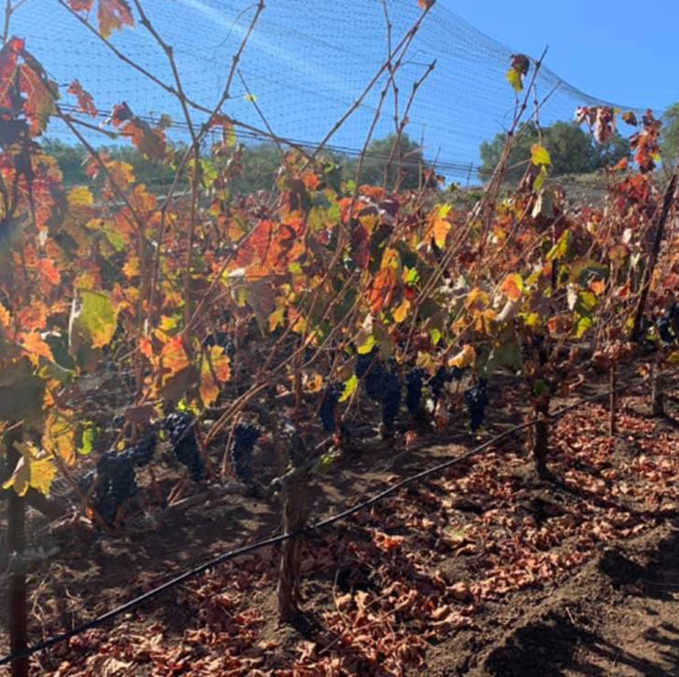

Mothballing Vineyards in a Challenging Market
Dr. S. Kaan Kurtural
Wilbur-Ellis Agribusiness
Senior Agronomy Information Technology Manager

Slide 2
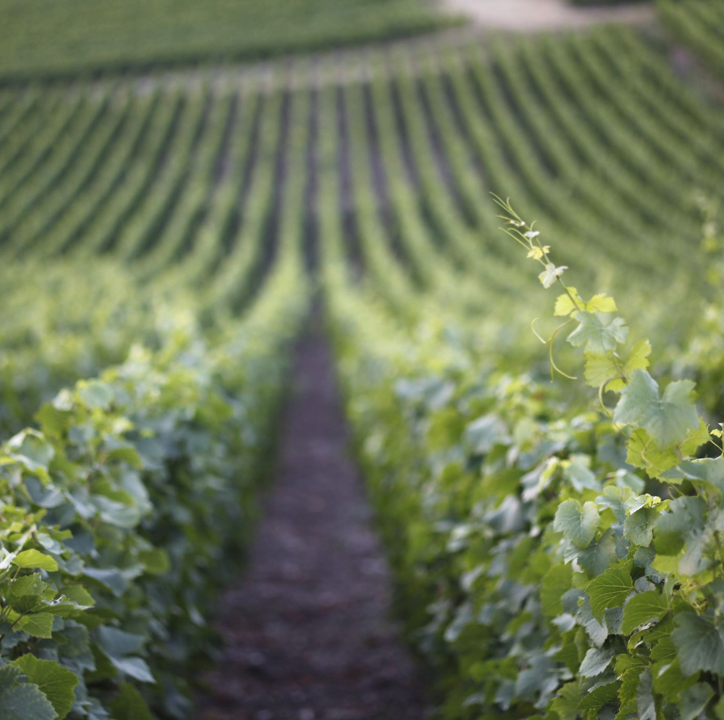
What should be considered during Mothballing Vineyards?
Business decision
Cultural practices
Pruning
Mineral Nutrition and Irrigation
Plant Protection
Harvest Concern

Slide 3
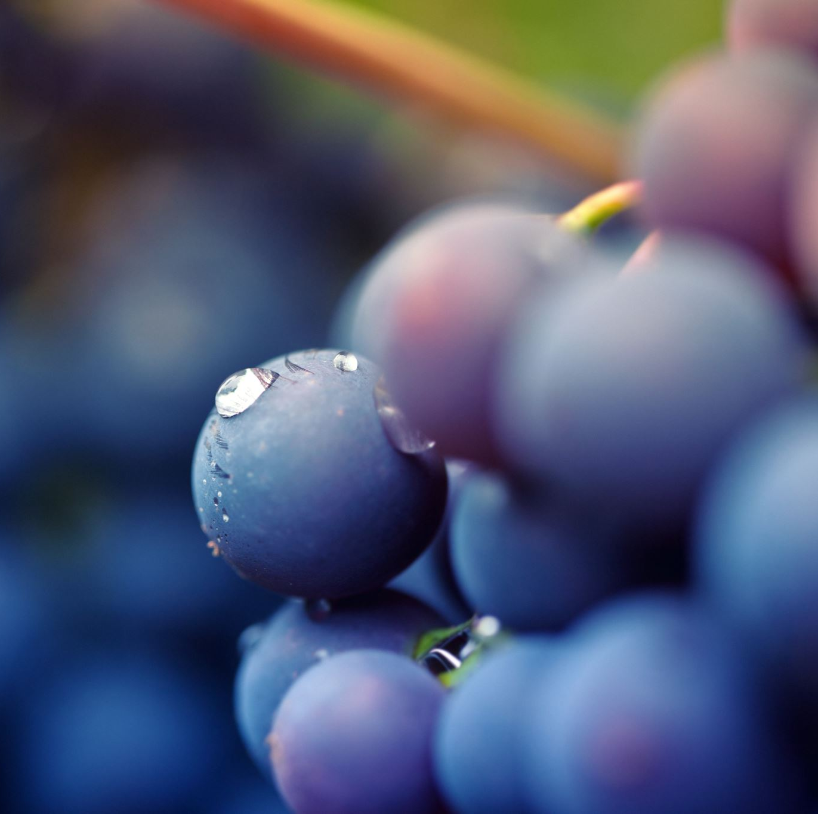
What is the goal?
Business decision:
Additional time to diversify
Oversupply of grapes due to cheaper imports
Significantly reduce management costs

Slide 4
Cultural practices
Dormant pruning:
AIM:
REDUCE GROWTH and CROP LEVEL
Can I skip dormant pruning?
Short answer: NO
Aim is to reduce crop level
Make the healthiest CANOPY POSSIBLE

Slide 5
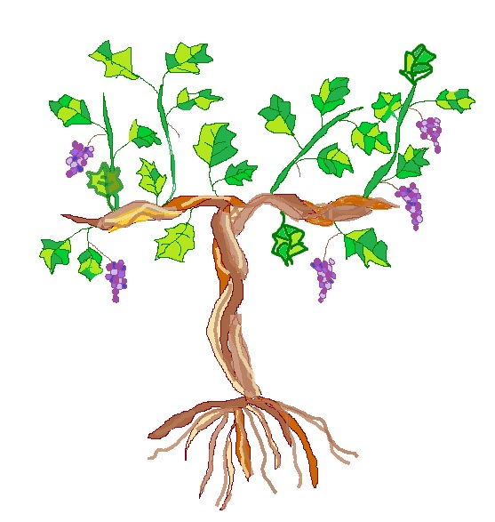
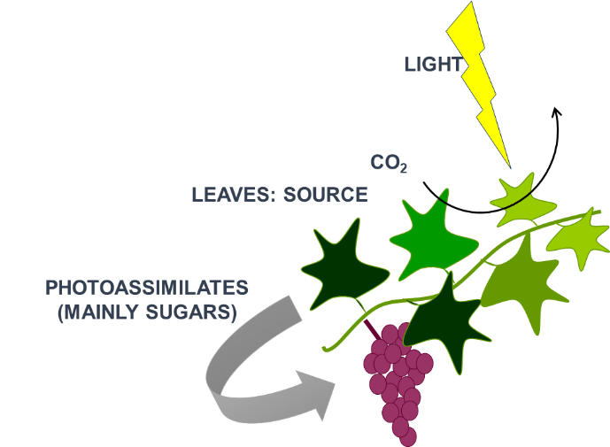
Grapevine is a perennial crop
Sources
Photosynthesis
Transport via phloem
Sinks
Carbohydrates
Assimilation
Storage
From: Torres et al. 2021 Front. Plant. Sci.
Notes:
A sustained moderate water deficit may improve canopy microclimate, increase water use efficiency, control vigor, and reduce berry size improving berry quality by means of enhancement of sugars and flavonoids in red wine grape. Nevertheless, the final berry composition and consequent wine quality are highly dependent upon the proper control of carbohydrate partitioning, which balance the growth and metabolism of the source:sink organs.

Slide 6
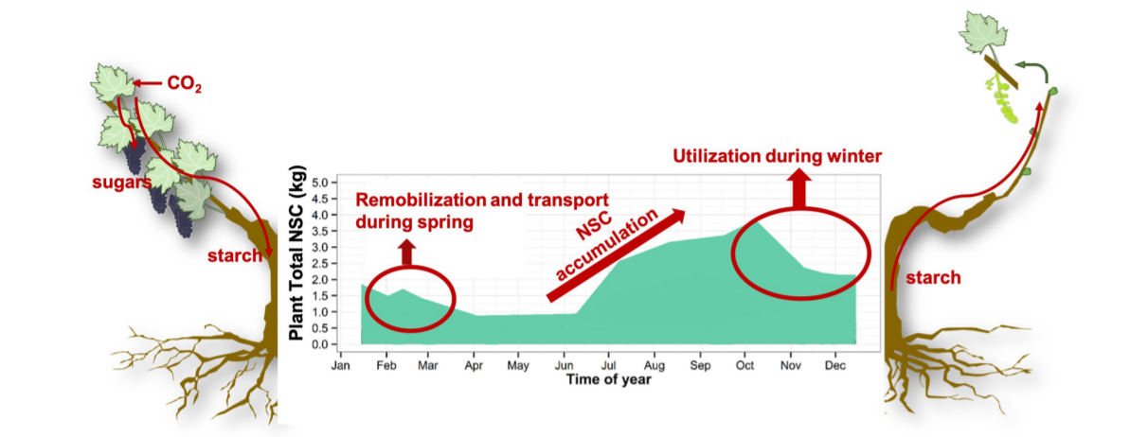
What are non-structural carbohydrates?
Non-structural carbohydrates (NSC):
Provide energy and carbon for grapevine growth
Stored as reserves in grapevine perennial organs
NSC in the early season is crucial until bloom
From: Tixier et al., 2019 Front. For. Glob. Change
Notes:
Non-structural carbohydrates are responsible for providing energy and carbon for grapevine growth, being stored as reserves in grapevine perennial organs. The role of stored NSC in the early season is crucial until bloom when leaf photosynthesis becomes the primary source of carbon.
The capacity of grapevines for replenishing these carbohydrate reserves increases at mid-ripening and sugars directly or indirectly control a wide range of physiological processes, including photosynthesis, sugar transport itself, nitrogen uptake, defense reactions, secondary metabolism, and hormonal balance.

Slide 7
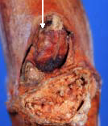
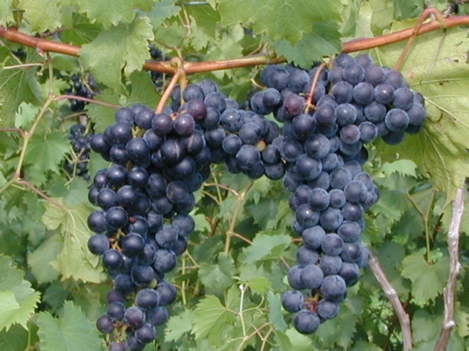
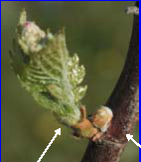
Grapevine fruiting characteristics
Fruiting shoots are born on one-year old dormant buds
Because of this character trait, we prune to replace the fruiting wood each year
Pruning results in removal of 80 – 90% of the dormant canes per year
Dormant bud
One year old wood
One year old wood
Current season’s shoot

Slide 8
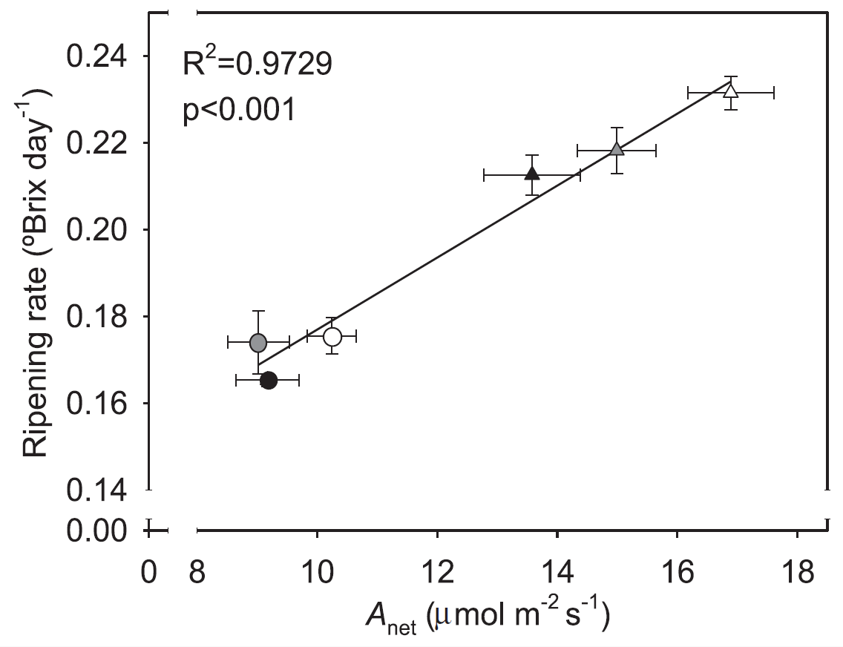
Role of canopies: To fix Carbon – Make Sugar!
Light
O₂
CO₂
Leaves: Source
Photoassimilates
(mainly sugars)
Fruit: Sink
Roots: Source and Sink
Martinez-Luscher et al., 2015 Plant Science

Slide 9
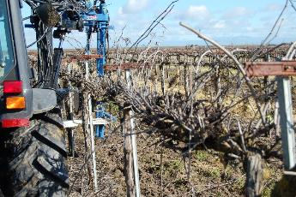
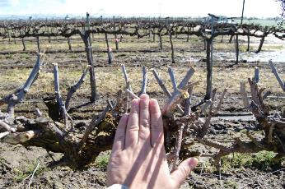
DORMANT PRUNING while MOTHBALLING
Box-pruning
Prune to a 2” to 3” hedge
At most 4 “ wide
Remove all sprawl
Make the smallest bearing surface you can possibly make
DO NOT LEAVE THEM UNPRUNED
Too much leaf area
Many small clusters
Greater irrigation requirement
In-season DISEASE Pressure

Slide 10
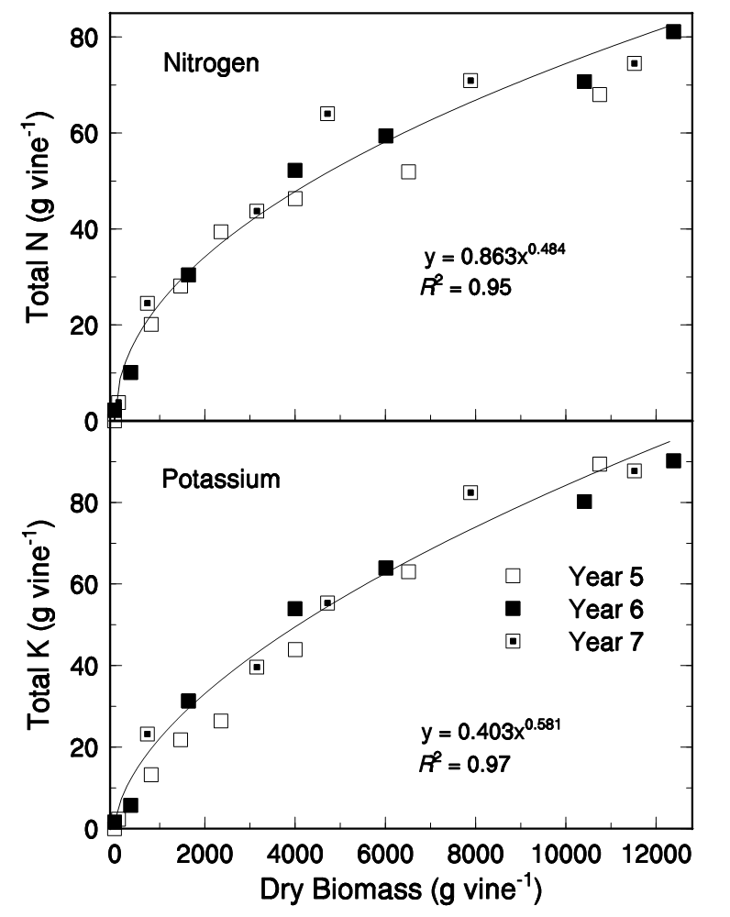
Mineral Nutrition and Irrigation
What drives Mineral Nutrition:
GROWTH
Dry biomass production of field-grown grapevines was a linear function of grapevine water use across the growing season.

Slide 11
The amount of N per ton of fruit at four vineyard locations across three years.
 | Total N (lbs/Ton of Fruit)
Location | Year1 | Year2 | Year3
Carneros (Chardonnay) | 2.68 | 2.50 | 2.58
Gonzales (Chardonnay) | 2.48 | 2.56 | 2.88
Oakville (Cab. Sauvignon) | 1.96 | 2.48 | 2.70
Paso Robles (C.S.) | 3.16 | 3.02 | 2.76

Slide 12
The average, high and low amounts of several mineral nutrients in one ton of fruit from grapevines.
Mineral Nutrient | Average | High |  | Low
 | ---------------(lbs. / t)-----------------
N | 2.92 |  | 4.12 | 1.80*
P | 0.56 |  | 0.78 | 0.44*
K | 4.94 |  | 7.38 | 3.18*
Ca | 1.00 |  | 1.86 | 1.08*
Mg | 0.20 |  | 0.32 | 0.10*

Slide 13
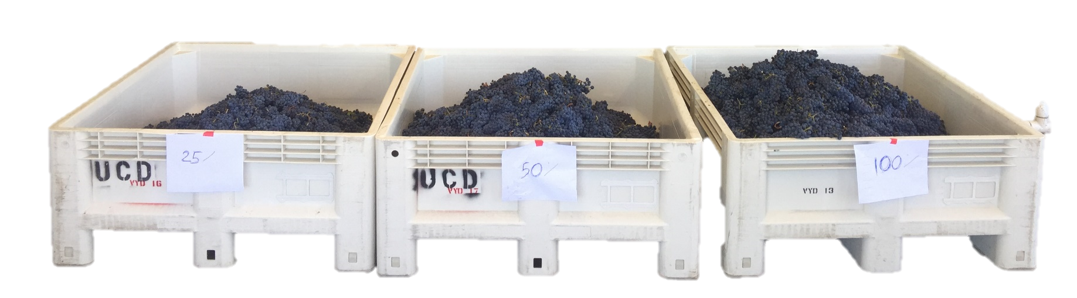
Reduction of Yield by Irrigation Amounts
 |  | Clusters per vine | Yield | Leaf area to fruit ratio | Berry mass
 |  | (no) | kg/vine | (m²/kg) | (g)
2019
Treatments
 | 25% ET_{c} | 56 ± 1 | 6.78 ± 0.45 c | 0.472 ± 0.021 b | 1.08 ± 0.04 c
 | 50% ET_{c} | 58 ± 1 | 8.83 ± 0.44 b | 0.409 ± 0.029 b | 1.20 ± 0.04 b
 | 100% ET_{c} | 59 ± 1 | 10.35 ± 0.38 a | 0.726 ± 0.024 a | 1.37 ± 0.03 a
ANOVA |  | ns | *** | *** | ***
2020
Treatments
 | 25% ET_{c} | 55 ± 1 | 4.80 ± 0.31 c | 0.499 ± 0.037 b | 0.85 ± 0.05 b
 | 50% ET_{c} | 53 ± 1 | 6.26 ± 0.32 b | 0.341 ± 0.013 c | 1.08 ± 0.02 b
 | 100% ET_{c} | 53 ± 1 | 9.14 ± 0.25 a | 0.838 ± 0.047 a | 1.15 ± 0.02 a
ANOVA |  | ns | *** | *** | ***
From: Torres et al., 2021 Front. Plant Sci.
Notes:
Cluster number was not affected by the replacement of different fractions of ETc. An increase in the yield per grapevine was observed in both seasons with a highly significant increase in yield per grapevine in 100% ETc treatment. Likewise, the linear increase in yield was evident from 25% ETc to 50% ETc as well, in both years. We also measured linear increases in leaf area to fruit ratio and berry size as the amount of irrigation increased from 25% ETc to 100% ETc

Slide 14
Can I skip irrigation and fertilizer all together?
I wouldn’t recommend it
However, you can reduce it significantly
Apply at most 25% ETcrop replacement
It is needed to keep a healthy leaf area
Move nutrients into rhizosphere
Maintain hydroskeleton of CANOPY
Mineral nutrition needs
DO NOT SKIP
At least 1/6th of a producing vineyard
Most important to replace:
Nitrogen and POTASSIUM
For LEAF AREA maintenance
Non-structural Carbohydrates
Upcoming seasons’ fruiting
LATENT BUDS

Slide 15
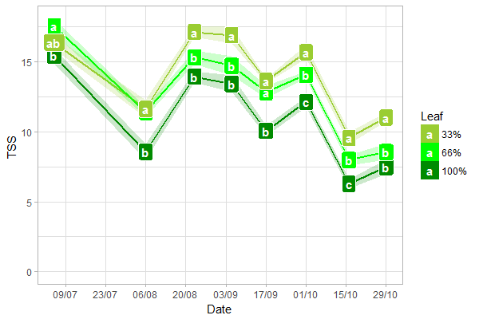
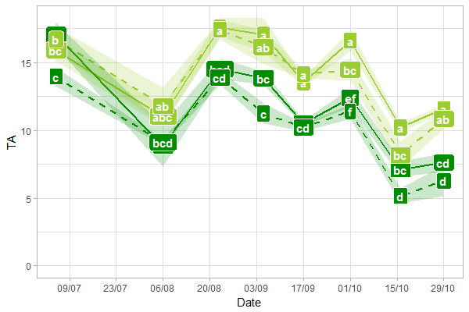
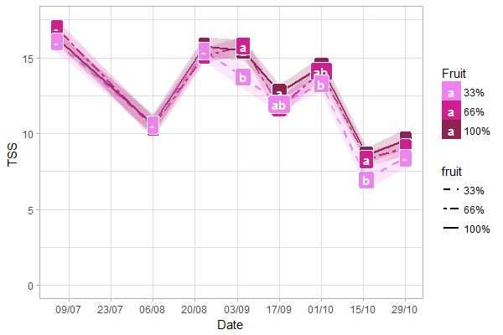
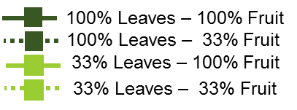
Leaf area determines carbon fixation: NOT FRUIT
(net photosynthesis)
Main effects in Two-way ANOVA (post hoc)
Effect of defoliation
Combination treatments
Harvest
Over cropped
A_{net} (μmol CO² m⁻² s⁻¹)
A_{net} (μmol CO² m⁻² s⁻¹)
Effect of crop load
Under cropped
A_{net} (μmol CO² m⁻² s⁻¹)
100% Leaves – 100% Fruit
100% Leaves – 33% Fruit
Only extreme treatments plotted
33% Leaves – 100% Fruit
33% Leaves – 33% Fruit

Slide 16
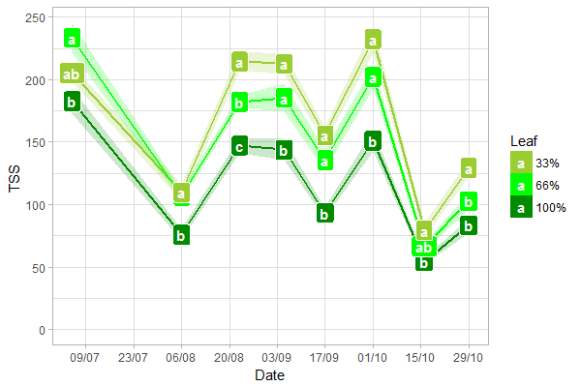
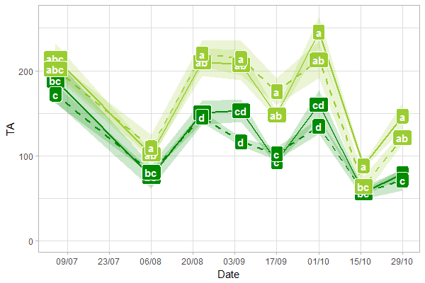
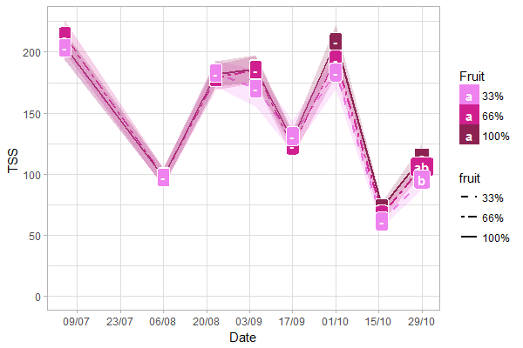
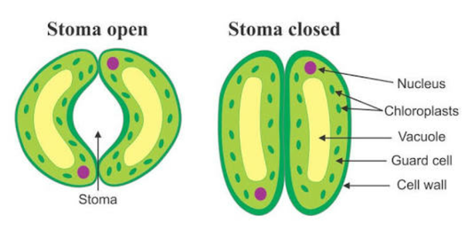
Leaf area determines plant water status:
NOT FRUIT
Main effects in Two-way ANOVA
Effect of defoliation
Combination treatments
g_{s} (mmol H₂O m⁻² s⁻¹)
g_{s} (mmol H₂O m⁻² s⁻¹)
Effect of crop load
Only extreme treatments plotted
g_{s} (mmol H₂O m⁻² s⁻¹)

Slide 17
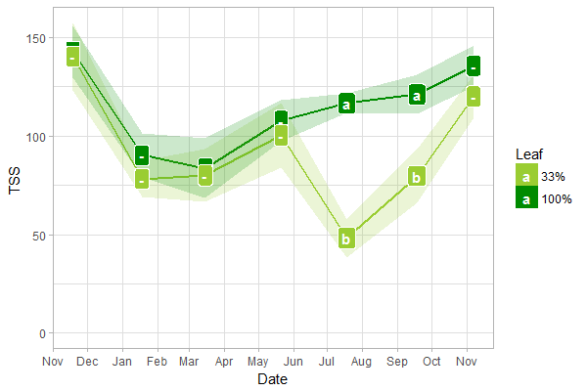
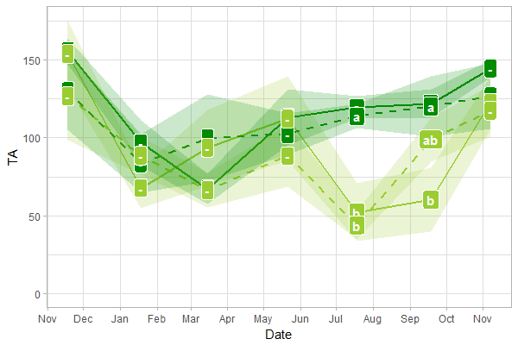
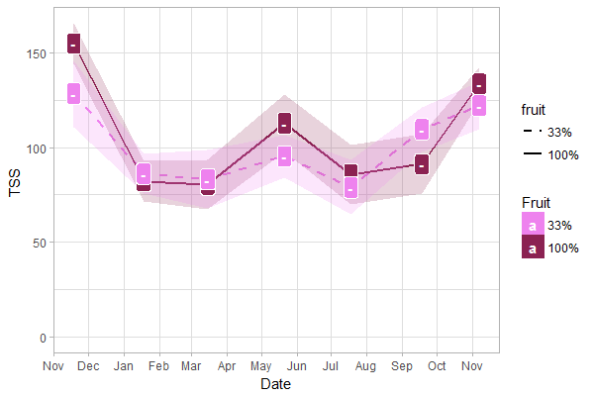
Leaf area determines plant reserves: NOT FRUIT
Main effects in Two-way ANOVA
Effect of defoliation
Treatment application
Harvest
Last week
Root starch (mg g⁻¹ DM)
Effect of crop load
100% Leaves – 100% Fruit
100% Leaves – 33% Fruit
33% Leaves – 100% Fruit
33% Leaves – 33% Fruit

Slide 18
Should you DROP UNSOLD FRUIT?
Harvest is completed 10 to 40 days post-plateau of sugar accumulation
(10 to 40 days after 21% TSS berry)
Carbohydrate reserves in grapevine are usually filled before harvest
Directly affected by leaf area
Cluster number has no effect
Harvest date has no effect
Leaving unsold clusters on the vine has NO effect on the CHO balance
Antalick A., et al. (2021). OenoOne, DOI:10.20870/oeno-one.2021.55.2.4527
Candolfi-Vasconcelos, M. C., et al. (1994). Planta 192, 567–573. doi: 10.1007/BF00203595
Deloire, A. (2013). 15th Australian Wine Industry Technical Conference, Sydney, New South Wales. 47-50.
Martinez-Luscher and Kurtural (2021). Front. Plant . Sci. https://doi.org/10.3389/fpls.2021.695319
Rossouw G.C., et al. (2017). Scientia Horticulturae (216), 215-225.
Torres N., et al. (2021). Front. Plant Sci., https://doi.org/10.3389/fpls.2021.633600
Vrignon-Brenas S., et al. (2019). OenoOne, DOI : 10.20870/oeno-one.2019.53.2.2431
Zapata, C., et al. (2004). J. Plant Physiol. 161, 1031–1040. doi: 10.1016/j.jplph.2003.11.009

Slide 19
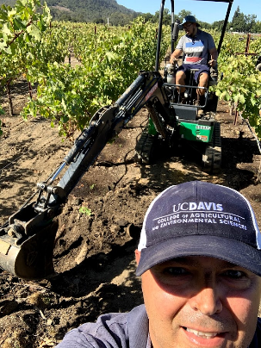
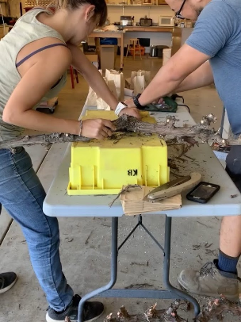
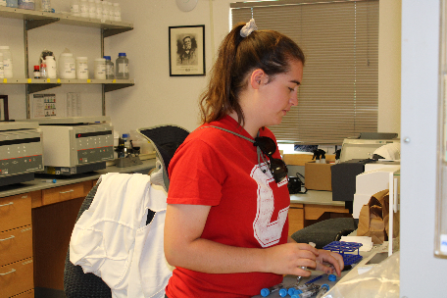
Sugar plateau and root starch replenishment in Cabernet Sauvignon
Between 11 August to 20 August
Anthocyanins mg/g
% Total soluble solids in must
Martinez and Kurtural 2021 Frontiers in Plant Science

Slide 20
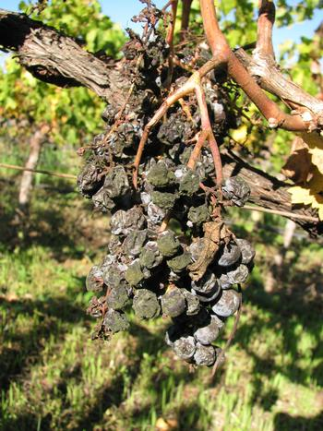
Phytosanitary concerns of leaving fruit on the vine
Over production
It happens, we get paid by the ton
We import more wine since 2014
Cultivar out of favor
‘Bottleshock effect’
Contract cancellation
It happens, we get paid by the ton
We import more wine since 2014
Smoke effects
Global change
© UC Regents, Rhonda Smith

Slide 21
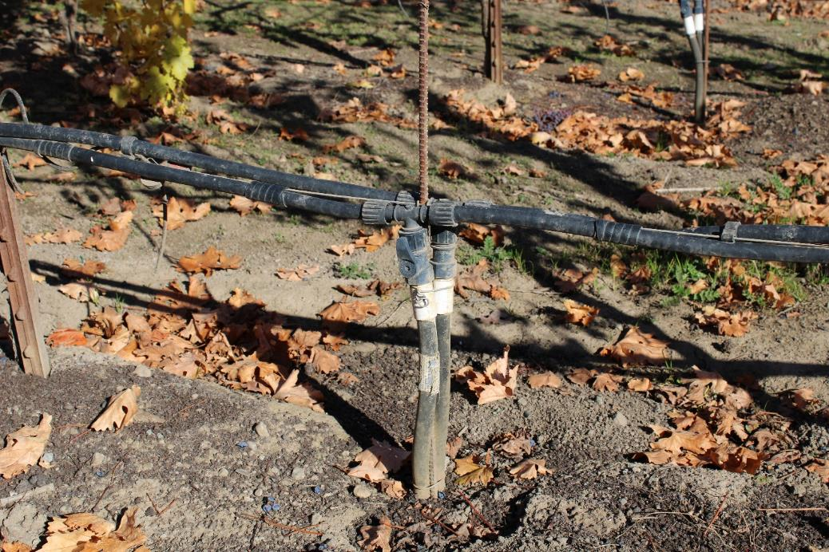
All common pathogens exist in the vineyard
Decaying berries only ONE source of pathogens
Fallen petioles
Fallen leaves
Rachis after mechanical harvest
Tendrils on the trellis
Irrigation lines
© Kurtural and Fidelibus (2021)

Slide 22
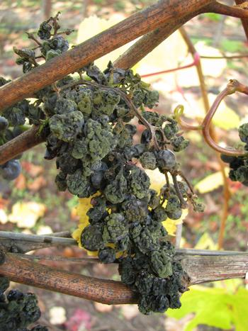
Fungi on decaying berries
Same fungi as growing berries!
Botrytis cinerea
Cladosporium
Asperigillus spp.
These fungi may infect berries due to damage due to
Sun burn
Diffuse or unseen powdery mildew
© UC Regents, Rhonda Smith

Slide 23
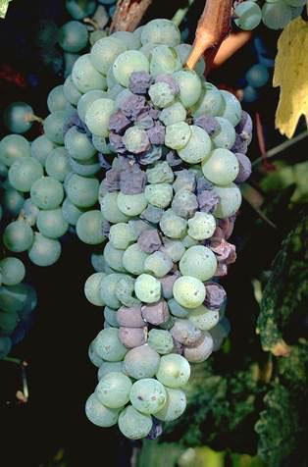
Botrytis cinerea is ubiquitous
Survives on dead tissue
Infects live tissue
Grows on dead flower caps and stamens
Infects young berry when cap is shed
Sporulation was observed from prunings, rachis collected from vineyard floor
© UC Regents

Slide 24
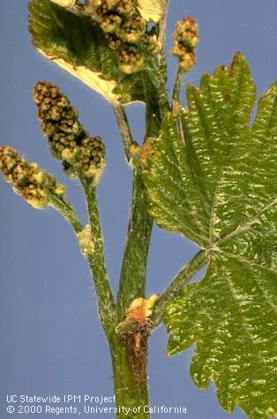
What Affects Inoculum Carry Over ?
Fungi has to be present
Neighbors
WEATHER!
Vine phenology
Date of bud break
Bloom
Vineyard FLOOR MANAGEMENT

Slide 25
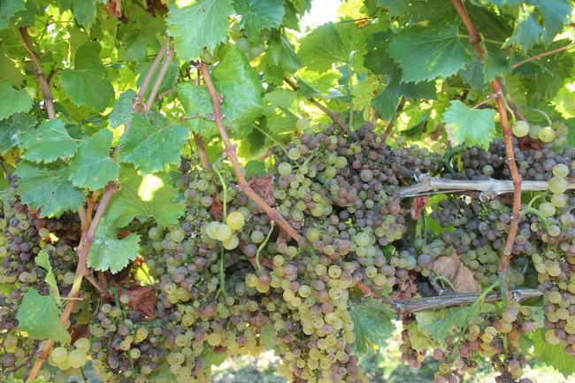
Does leaving fruit on the vine have an adverse effect?
Decaying fruit will drop to vineyard floor
Decaying fruit is subject to bird herbivory
90% of wood will be pruned
PRIOR to bud break
Obligate parasites released from fungal fruit bodies have NO impact
There is nothing to infect
ELIMINATING pruning wood and old fruit at pruning
Chipping
Incorporating
Hauling
Common ground cover management

Slide 26
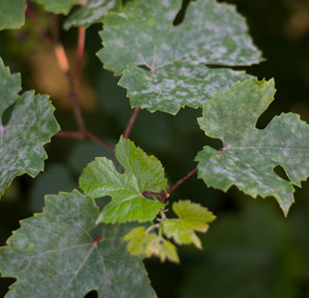
PhytoSanitary Concerns During Mothballing
Do I have to run a full program?
Short Answer: NO
Do I still have to protect?
YES
Canopy health more important
Powdery Mildew in Season

Slide 27


Recommended Low-Cost Program
Sulfur DF
5 lbs/A
100 gal Water
Start with Delayed Dormant Sulfur Spray
Timing
At Least 4
Cover Sprays
Until 9% Brix
Add to Cover Sprays
Add 2 oz/A
αβ Harpin Protein
Employ
At least two instances
Ensures:
Systemic acquired resistance
Better leaf health
Water and N use

Slide 28
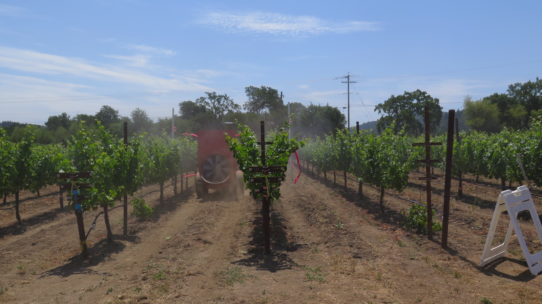
Is your Sprayer Ready for a Different Way of Farming?
GPA (gal/acre) = Flow rate-GPM (gal/min)
Land rate (ac/min)
Coverage
Land Rate:
not just tractor speed
Area covered per unit time (ft.²/min)
Speed (ft/min) x Row width (ft.)
Convert ft.²/min to acres/min

Slide 29
How to use the basic calibration formula for spraying
GPA (gal/acre) = Flow rate-GPM (gal/min)
Land rate (ac/min)
Notes:
Gallons per acre is determined by the flow delivered to a certain area in a set amount of time. So, to accurately calibrate a sprayer, you must measure flow rate (gallons per minute from the sprayer) and land rate (area covered by the spray in acres per minute). As you will see in this presentation, the major variables are:
Ground speed
Nozzle(s) flow rate
System pressure
GPA = GPM/APM
Note: Because GPA is determined from GPM and APM, changing either GPM and/or APM effects GPM. You can’t change one without influencing the others.
Some examples: increasing your flow rate a the same land rate means higher GPA output. If you change your GPA, but need to maintain the same ground speed, you will need to increase flow rate, perhaps by adding nozzles or increasing the nozzles sizes of the same number of nozzles. Final example, if you increase ground speed, which will increase land rate, then you will decrease GPA if Flow rate isn't increased.

Slide 30
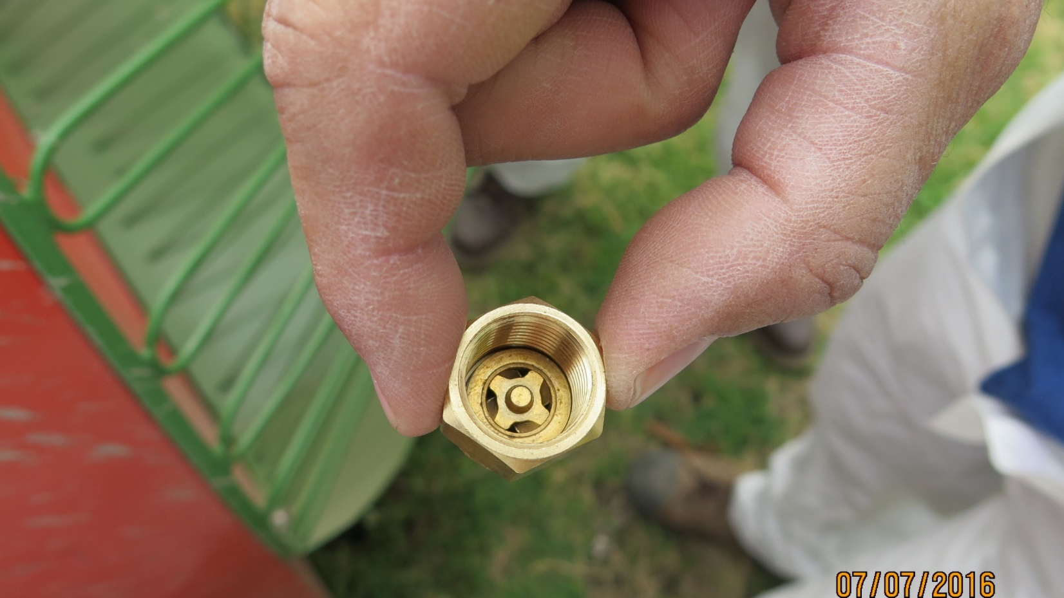

Slide 31
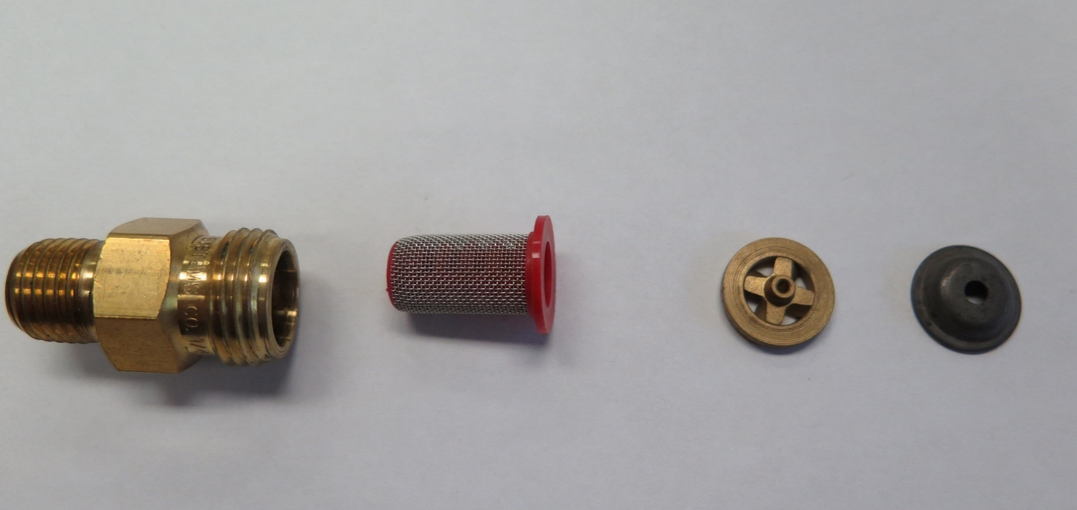
Disc-Core set up.
2 Nozzle choices combine for one flow rate.
Disc
Core or “spinner plate”
Liquid speeds up as exits (it doesn’t really spin).

Slide 32
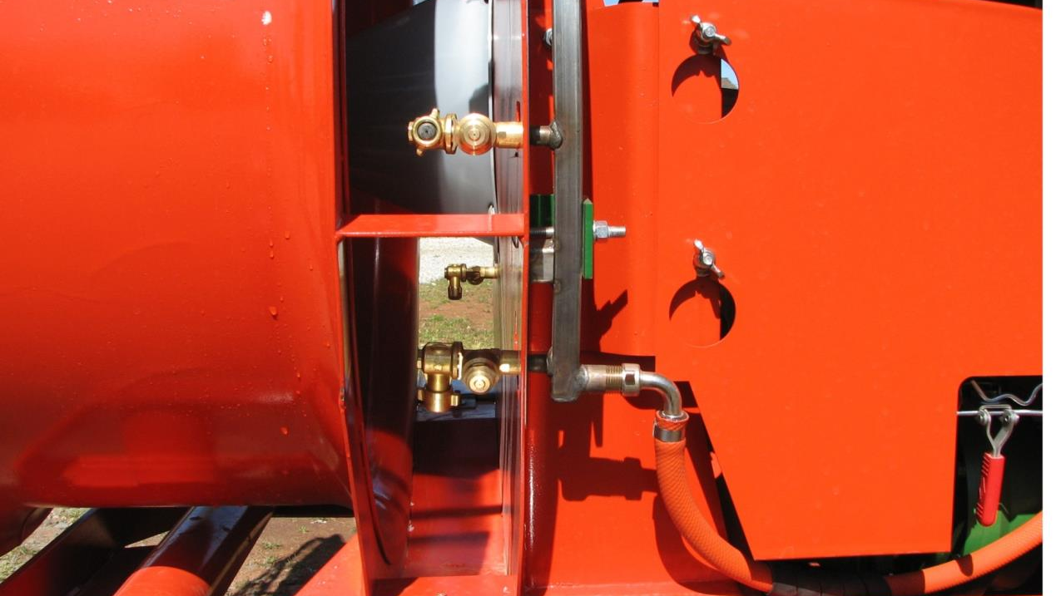

Slide 33
What does the nozzle contribute to our spray application?
1. FLOW RATE: Volume/Time (Gallons/Min)
Nozzle flow rate is directly proportional to application rate (Gallons/acre)
Want a larger spray volume? Increase the flow rate by either:
Increase nozzle size (Larger droplets*)
Increase pressure (Smaller droplets)
2. DROPLET SIZE (COVERAGE/DRIFT)
* Except for VENTURI sprayers, where droplets are always fine.

Slide 34
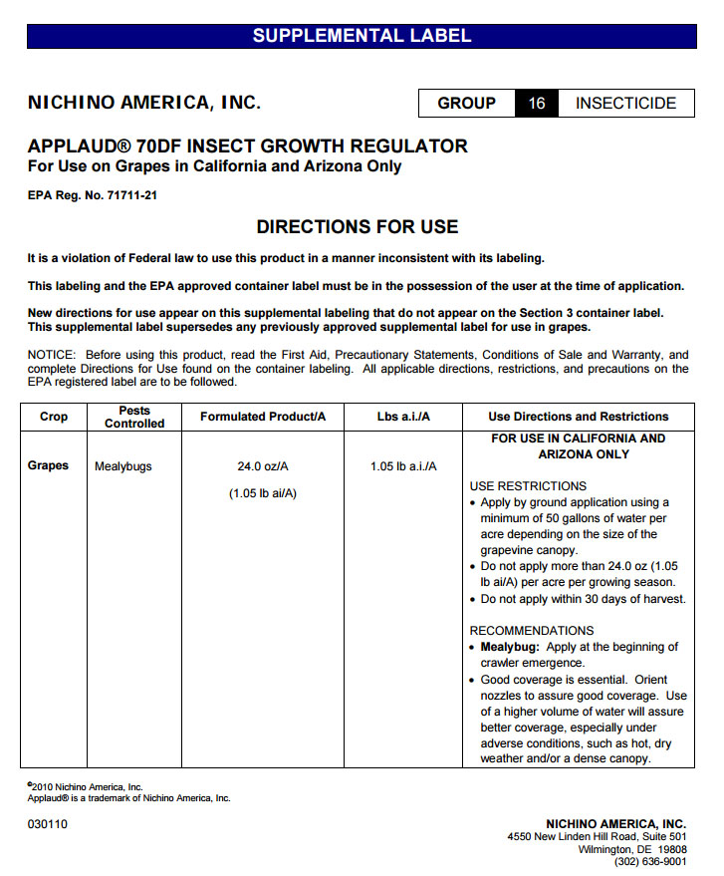
First and Final Step: READ and FOLLOW the LABEL. The label specifies the amount of pesticide, typically “per acre”
For this example, the label recommended rate in grapes is no more than 24 oz./acre per growing season to control mealybugs. This label also states that good coverage is essential and to use higher volumes under adverse conditions or with dense canopies.

Slide 35
How much pesticide in the tank? Determine how many acres your tank can spray at your calibrated rate.
In our example, say it is a 400 gallon tank.
The label for the spray job will provide a rate per acre, in our example we choose 12 oz. per acre.
We calibrate our sprayer to deliver 118 gallons per acre.
Number of acres per tank: 400 gallon tank/118 gallons per acre= 3.4 acres can be sprayed with a full tank at this calibration.
Amount of pesticide per tank: 3.4 acres * 12 oz. per acre=
41 ounces of pesticide per tank in this example.

Slide 36
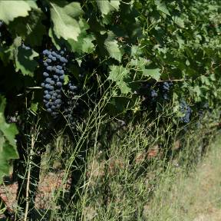
Ground Management During Mothballing
Why manage weeds during mothballing?
Direct competition
Excess water stress
Frost protection
Harboring other pests (e.g. TCA)

Slide 37
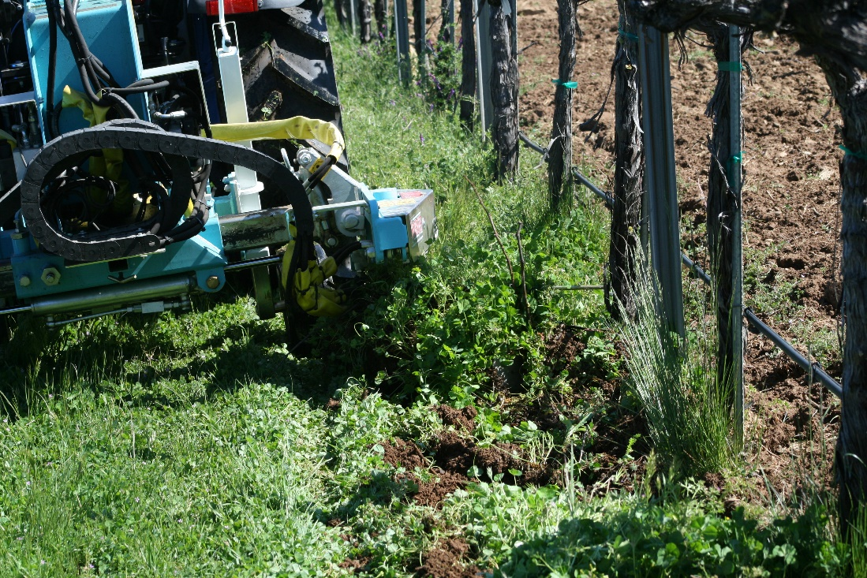
Tillage vs. Chemical Control During Mothballing
Economic considerations
Labor costs
Timing of application
Times of application
Fuel and chemical costs

Slide 38
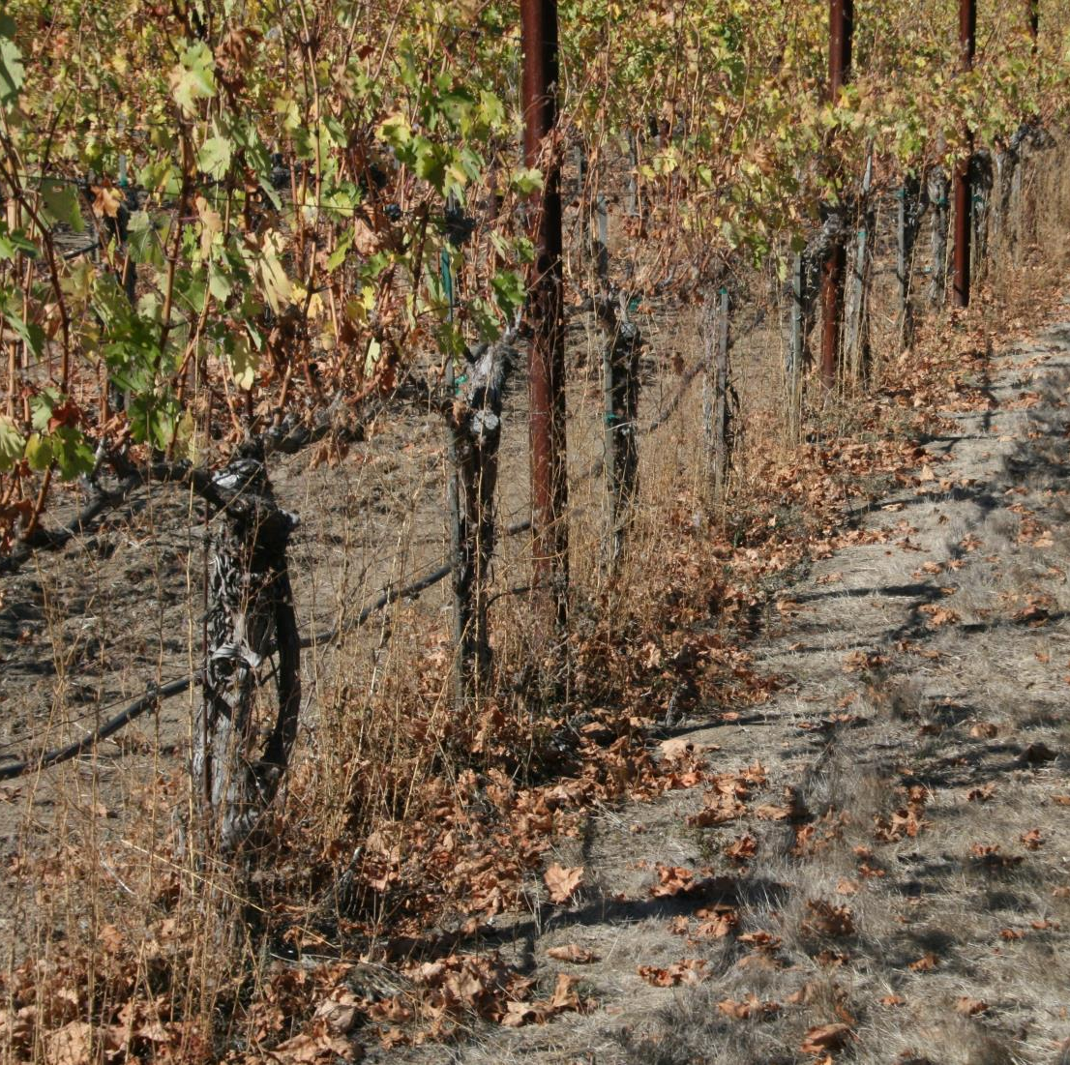
Recommendation for Mothballed Vineyards
Row middles
Clean tillage
Undervine management
Residual herbicides?
I would not skip it
Post-emergence
Good quality NIS
Water conditioner
Glufosinate or Glyphosate based on your market

Slide 39
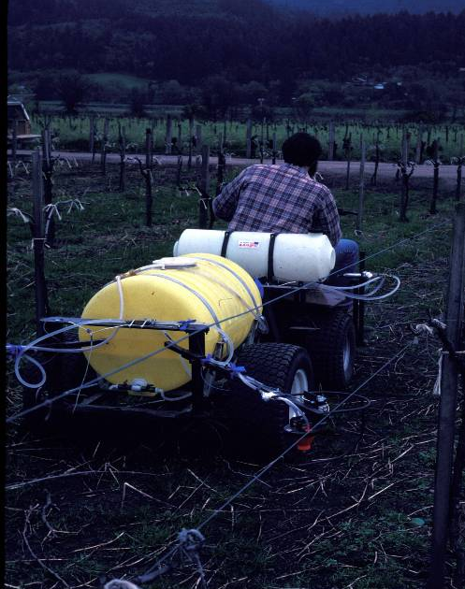
Chemical Weed Control in Mothballed Vineyard
Residual herbicide
Chateau/Surflan/Goal/Prowl
Efficax as Adjuvant
Water Conditioner (Cynder or AMS depending or Hardiness)
Good quality burn down herbicide
Post-emergence
Full rate glufosinate or glyphosate
Water conditioner (Cynder of AMS)
Good quality MSO (Syl-Tac)

Slide 40
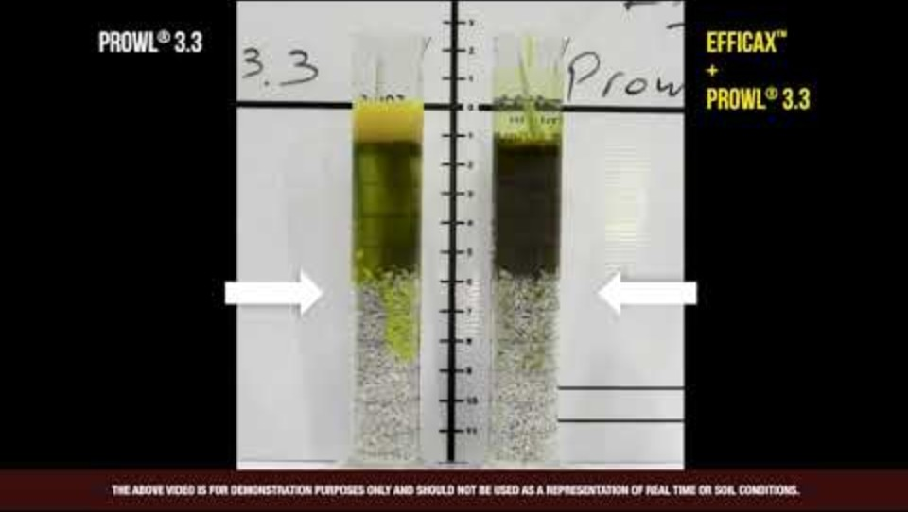
Why am I recommending an adjuvant?
Additional 2 weeks of residual activity
It can push your first burn down spray well into June

Slide 41
Return Bloom Comparison After One-Season of Mothballing (2020-2021) 7 x 5 VSP Trellised CS/3309
 | # of buds/vine | # flowers/vine | # berries/cluster | Yield (tons/A)
Non-pruned | 432 a | 221 | 88 c | 4.8 c
Box-pruned (2”) | 134 b | 310 | 98 b | 7.2 a
Hand-pruned (24 buds) | 88 c | 68 | 102 a | 4.8 c
Box-prune crop picked | 136 b | 309 | 99 b | 7.4 b
Hand-pruned crop picked | 91 c | 66 | 100 b | 5.1 b

Slide 42
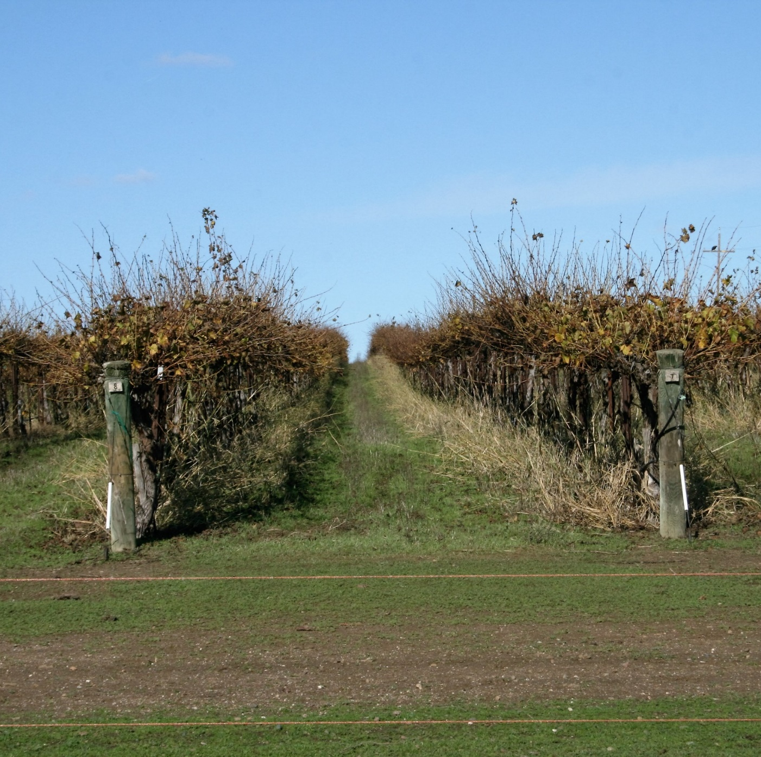
Recommendations Based on a 2 Year Trial
February residual herbicide
Chateux and Efficax
Glufosinate
Box-prune to 2 inch hedge
Delayed dormant Sulfur at 5 lbs/A
6-3-12 North Coast WECO Blend at 4 gal/A
Sulfur DF Starting at 6-8” inch (4 X)
Irrigation at 25% ETcrop starting in June
June Glyphosate spray with Cynder and AMS

Slide 43
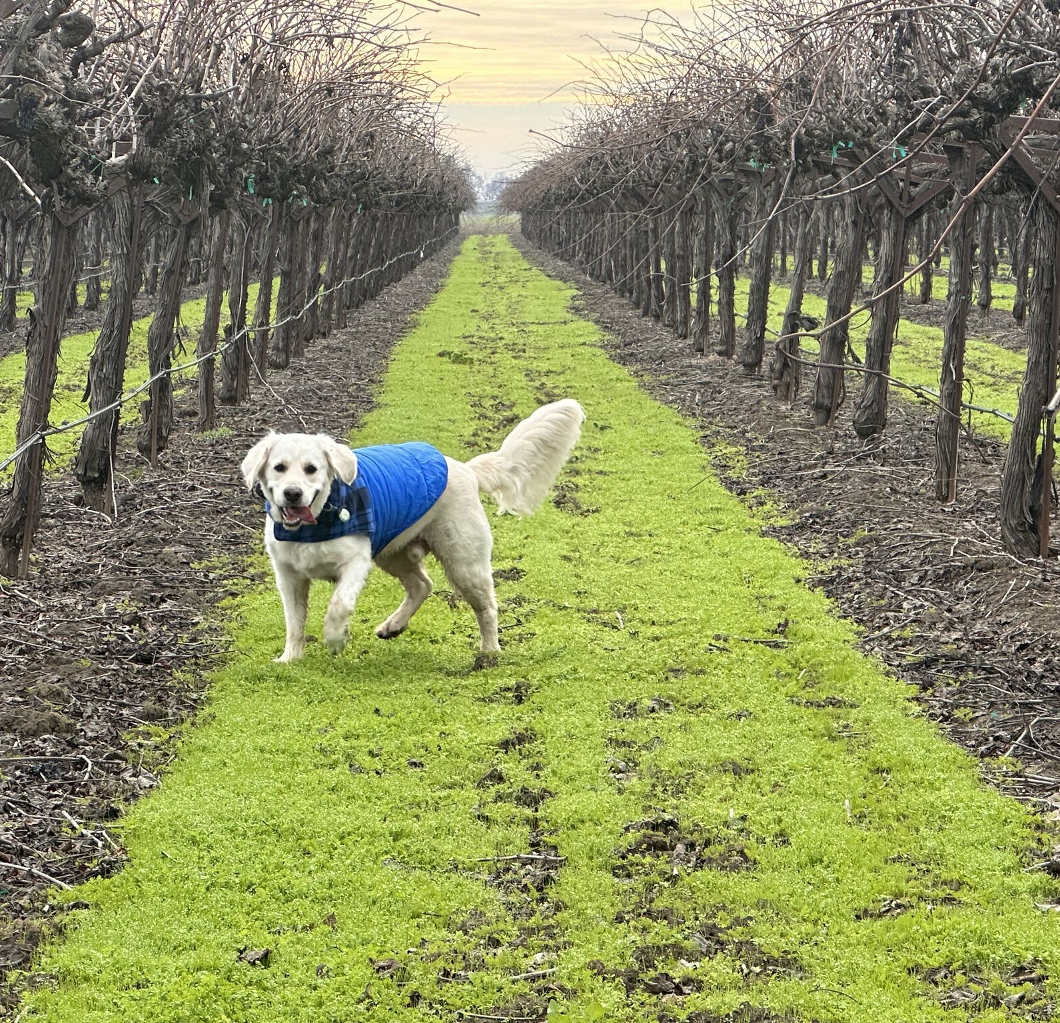
Perspectives
Mothballing a Vineyard
Economic decision
Can also give the opportunity to change cultivar (grafting)
It is a smart decision
Vineyard removal is irreversible and expensive
With MASC funds will keep the family a float

